Slide 1
UNIT CODE: SIT 408
UNIT TITLE: SIT408: GEOGRAPHICAL INFORMATION SYSTEMS
Prerequisite: Database Management Systems
LECTURER: Steve Kariuki
0725583767

Slide 2
Learning Objectives
Upon successful completion of this UNIT, you will be able to:
Describe the basic components of map making
Use GIS software and perform map projections and distortions
Use metadata, documentation, and instructions to solve simple technical problems, decide what kind of map they need to make, and evaluate the quality of data from various sources.
Evaluate other people's maps.
Manipulate large databases and present the material graphically in clear, readable maps.

Slide 3
Information Systems
An integrated set of components for collecting data, processing data, providing information, Storing data and transmitting data between information system users.
Examples
  IFMIS
  KIEMS
  GIS

Slide 4
CBIS Vs Manual IS
Key User Needs
  Volumes Of Data Stored
  Speed of Data Processing
  Security features provided
  Data Versatility
  Concurrent Users

Slide 5
Information System Uses
Business Functions
  Process geospatial data
  Manage Human Resource
  Promote products and Services online
  Governments
  Provide services cost-effectively to citizens
  Collect and manage Taxes.

Slide 6
SYSTEM CONCEPTS
System concepts are studies that assist system analysts to understand how systems operate with an aim of improving them and aligning them with business needs

Slide 7
Systems share common characteristics
Systems have structure, defined by components/elements and their composition;
Systems have behavior, which involves inputs, processing and outputs of material, energy, information, or data;
Systems have interconnectivity: the various parts of a system have functional as well as structural relationships to each other.
Systems may have some functions or groups of functions
Systems have soft and hard properties

Slide 8
SYSTEM BOUNDARY
A system boundary is a boundary that separates the internal components of a system from external entities.
These entities can also be thought and be called as actors. In a use case diagram, a system boundary is represented by a rectangle that is drawn to enclosed the internal components of a system.
Any entities outside the rectangle (i.e. the system boundary) are hence the actors. To get a better idea you may do a search of the following term in Google Images:

Slide 9
SYSTEM ENVIRONMENT
The envrionment of a system are the surroundings of a system.
Computer-Based information systems operate under various Macro and Micro environmental factors such as :
Technology
Market Conditions
Laws and Policies
Political instability
Finances
E.t.c

Slide 10
TYPES OF SYSTEMS
Closed systems _These are systems that do not interact with the environment.
Open Systems _ These are systems that interact with the environment
Adaptive systems _ a set of interacting or interdependent entities, real or abstract, forming an integrated whole that together are able to respond to environmental changes or changes in the interacting parts.
Deterministic Systems _These are system whose output can be predicted from the input.e.g a comp program
Probabilistic Systems _ uses likelihood ratio theory to assign comparison outcomes to the correct, or more likely decision

Slide 11
SYSTEM ENTROPY
This is the state of a system in relation to its disorders.
Open systems have a low entropy rate compared to closed systems as they interact with the environment hence getting to know any kind of change posed by the environment.
Disturbances from the environment cause a high entropy in systems. Some disturbances are great that they threaten the existence of the system.
To reduce the entropy rate information and stimuli from the environment are injected in the system. Such a process is known as Negative entropy or Negonetropy.
This can be down through upgrading, decoupling subsystems and training of users among others

Slide 12
Geographic information system (GIS)
A geographic information system (GIS) is a computer system for capturing, storing, checking, and displaying data related to positions on Earth’s surface.

Slide 13
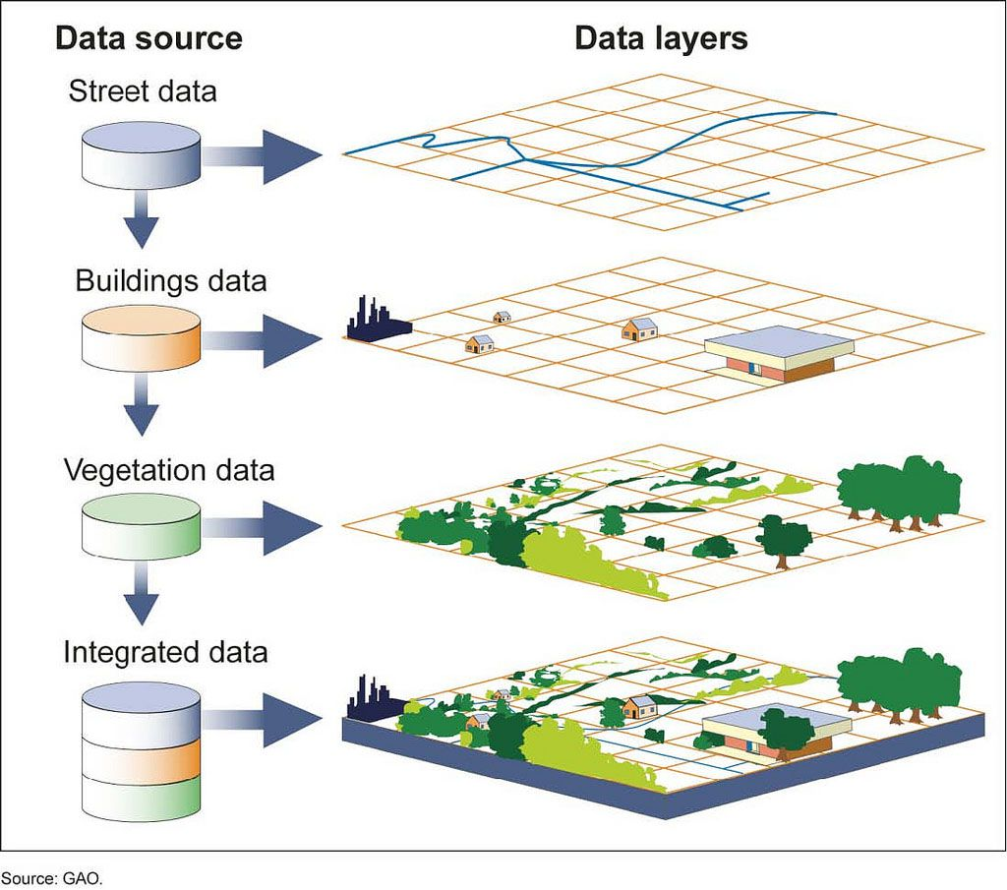

Slide 14
Geospatial data/Spatial Data
Information that describes objects, events or other features with a location on or near the surface of the earth.
Geospatial data combines location information (usually coordinates on the earth)
and attribute information (the characteristics of the object, event or phenomena concerned)
with temporal information (the time or life span at which the location and attributes exist).

Slide 15
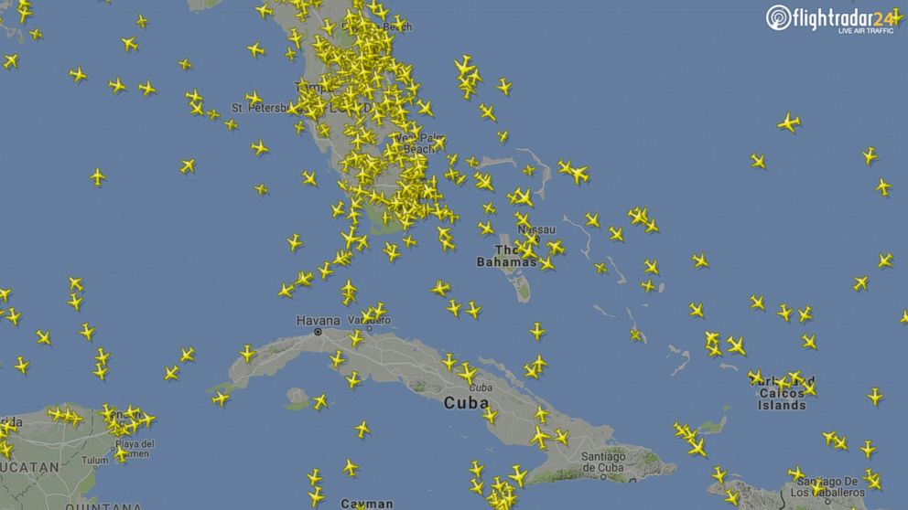
Flight Radar 2/7/2017

Slide 16
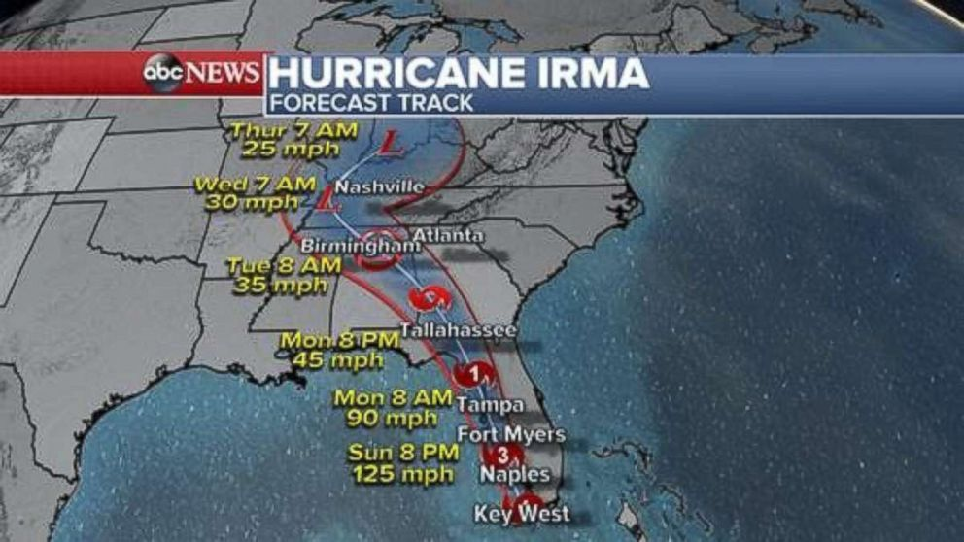
Huricane IRMA

Slide 17
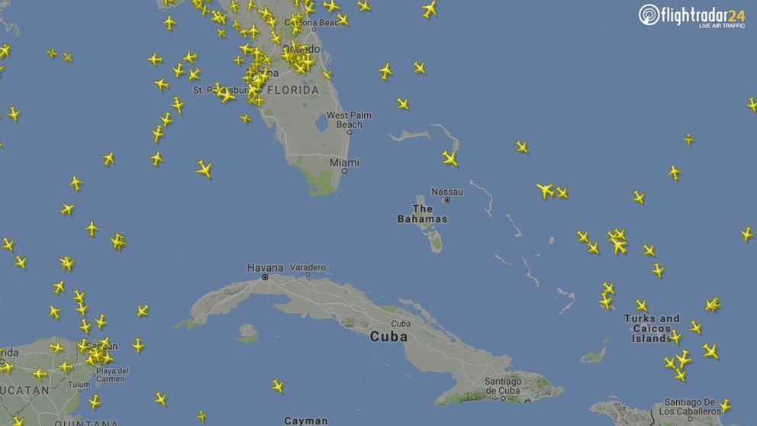
Flight Radar 10/Sept/2017

Slide 18
GIS FUNCTIONS
- Data acquisition (spatial and non-spatial)
  Data processing (data management)
  Data analysis (Spatial & statistical analysis)
  Data storage (Store data more efficiently)
  Data output (Maps, graphs, tables, reports)

Slide 19
GIS Applications
Telecommunication Equipment Set-up
City Planning
Weather Forecasting etc

Slide 20
GIS Components
Hardware: Hardware is Computer on which GIS software runs.
ArcGIS Server is server based computer where GIS software runs on network computer or cloud based.

Slide 21
Software Components:
GIS Tools: Key tools to support the browsing of the GIS data
RDBMS: Relational Database Management System to store GIS data. GIS Software retrieve data from RDBMS or insert data into RDBMS.
Query Tools: Tools that work with database management system for querying, insertion, deletion and other SQL (Standard Query Language).
GUI: Graphical User Interface that helps user and Software to interact well.
Layout: Good layout window to design map.

Slide 22
People: These are users of Geographic Information Systems. They run the GIS software.
Methods: For successful GIS operation a well-designed plan and business operation rules are important. Any organization has documented their process plan for GIS operation

Slide 23
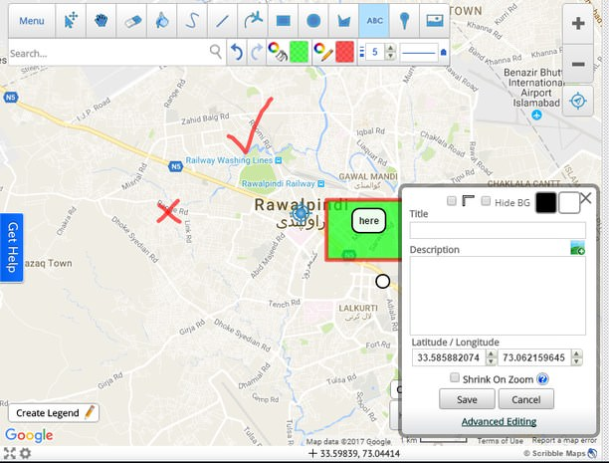
Data – (GIS Data Types)
Numeric data is statistical data which includes a geographical component or field that can be joined with vector files so the data can be queried and displayed as a layer on a map in a GIS.

Slide 24
Vector Data
A representation of the world using points, lines, and polygons.
They store information in x, y coordinates.
Vectors models are used to store data, which have discrete boundaries like country borders, land parcels and roads.

Slide 25
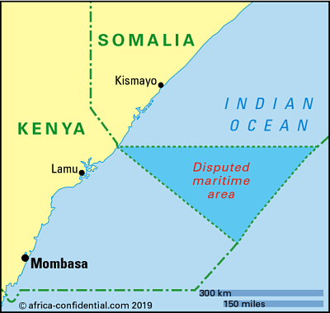

Slide 26
Raster Data
Rasters are digital aerial photographs, imagery from satellites, digital pictures, or even scanned maps.
A raster consists of a matrix of cells (or pixels) organized into rows and columns (or a grid) where each cell contains a value representing information, such as temperature

Slide 27
Developing a GIS using SDLC
GIS Investigation
GIS Analysis
GIS Design
GIS Implementation
GIS Monitoring and Support

Slide 28
GIS AUDITING

Slide 29
GIS audit
A system audit is the verification of a company’s GIS activities and the verification of the results needed to achieve the intended results.

Slide 30
Importance of GIS audit
Evaluate the actual performance of their operations compared to what was planned
Validate that the objectives pursued by the organization remain relevant
Validate whether or not the company is achieving those objectives
Ensure that the systems used are reliable
Review system records to ensure systems operate based on specifications
Identify vulnerabilities and risks
Allow a company to define a mitigation plan to better achieve its objectives
Monitor its operational systems to ensure they meet the objectives on an ongoing basis

Slide 31
Types of GIS Audit
An adequacy audit to evaluate a system and assess whether it meets the system requirements and specifications.
A compliance audit is to evaluate how a system is implemented within an organization to comply with certain standards.
A process audit is an audit of company processes as a whole in light of the objectives pursued.

Slide 32
Processes Involved
System review
Helps to understand the GIS IT infrastructure, the different layers, the management practices and system integration.
Vulnerability assessment
Involves verification of each application used by the organization and identify which ones are the most vulnerable.

Slide 33
Threat identification
Defines possible threats to the organization.
These may include external actors such as hackers, cybercriminals.
The external actors can also include a company’s vendors, suppliers and service providers.
They also face internal threats from their own users, programmers, system analysts and so on.

Slide 34
Internal controls
This involves evaluating the effectiveness of its internal controls against the standards or threats.
Testing
Involves testing and evaluating the various elements of the GIS system to ensure they meet their objectives and comply with the standards.

Slide 35
Reporting
The system audit report represents the auditor’s faithful assessment of the company’s GIS systems and whether or not the systems work as intended in light of the standards or defined objectives.

